Slide 1
L6. Bayesian Decision Analysis

Slide 2













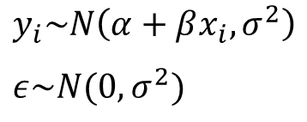



Bayesian Regression
Linear regression:
$$y_{i}=α+βx_{i}+ε$$
Probabilistic reformulation:
$$y_{i}\sim N\left(α+βx_{i},σ^{2}\right)$$
$$ε\sim N(0,σ^{2})$$
Fixed hyper parameters
$$θ$$
$$θ$$
$$θ=(α, β,σ)$$
$$α\sim N({μ_{α}=0,σ_{α}=20}^{2})$$
$$β\sim N({μ_{β}=0,σ_{β}=20}^{2})$$
$$y_{i}$$
$$y_{1}$$
…
$$y_{i}$$
…
$$y_{n}$$
$$σ\sim U(0,20)$$
$$x_{i}$$
$$x_{1}$$
…
$$x_{i}$$
…
$$x_{n}$$
$$i=1,…,n$$

Slide 3
Bayesian Regression
Jupyter Demo Simulation

Slide 4


Hierarchical Bayesian Regression
Group 1
$$\left(x_{1,1},y_{1,1}\right),\left(x_{2,1},y_{2,1}\right),…,\left(x_{i,1},y_{i,1}\right),…,\left(x_{n_{1},1},y_{n_{1},1}\right)$$
Group 2
$$\left(x_{1,2},y_{1,2}\right),\left(x_{2,1},y_{2,2}\right),…,\left(x_{i,2},y_{i,2}\right),…,\left(x_{n_{2},2},y_{n_{2},2}\right)$$
…
Group $j$
$$\left(x_{1,j},y_{1,j}\right),\left(x_{2,j},y_{2,j}\right),…,\left(x_{i,j},y_{i,j}\right),…,\left(x_{n_{j},j},y_{n_{j},j}\right)$$
…
Group $J$
$$\left(x_{1,J},y_{1,J}\right),\left(x_{2,J},y_{2,J}\right),…,\left(x_{i,J},y_{i,J}\right),…,\left(x_{n_{J},J},y_{n_{J},J}\right)$$

Slide 5








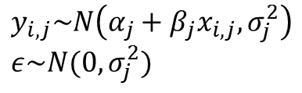













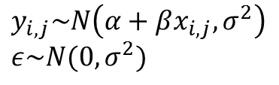









Hierarchical Bayesian Regression
Linear regression:
Linear regression:
$$y_{i,j}=α_{j}+β_{j}x_{i,j}+ε$$
$$y_{i,j}=α+βx_{i,j}+ε$$
Probabilistic reformulation:
Probabilistic reformulation:
$$y_{i,j}\sim N\left(α_{j}+β_{j}x_{i,j},σ_{j}^{2}\right)$$
$$ε\sim N(0,σ_{j}^{2})$$
$$y_{i,j}\sim N\left(α+βx_{i,j},σ^{2}\right)$$
$$ε\sim N(0,σ^{2})$$
Fixed hyper parameters
Fixed hyper parameters
$$θ_{1}$$
$$θ_{j}$$
$$θ_{J}$$
$$θ$$
$$θ=(α, β,σ)$$
$$θ_{j}=(α_{j}, β_{j},σ_{j})$$
$$α\sim N({μ_{α}=0,σ_{α}=20}^{2})$$
$$α_{j}\sim N({μ_{α}=0,σ_{α}=20}^{2})$$
$$y_{1}$$
…
$$y_{j}$$
…
$$y_{J}$$
$$y_{1}$$
…
$$y_{j}$$
…
$$y_{J}$$
$$β\sim N({μ_{β}=0,σ_{β}=20}^{2})$$
$$β_{j}\sim N({μ_{β}=0,σ_{β}=20}^{2})$$
$$σ\sim U(0,20)$$
$$σ_{j}\sim U(0,20)$$
…
$$x_{j}$$
…
$$x_{1}$$
$$x_{j}$$
$$x_{J}$$
$$x_{1}$$
…
$$x_{J}$$
…
$$y_{j}=(y_{1,j},y_{2,j},…,y_{nj,j)}$$
$$y_{j}=(y_{1,j},y_{2,j},…,y_{nj,j)}$$
$$x_{j}=(x_{1,j},x_{2,j},…,x_{nj,j)}$$
$$x_{j}=(x_{1,j},x_{2,j},…,x_{nj,j)}$$

Slide 6
Hierarchical Bayesian Regression
Linear regression:
$$y_{i,j}=α_{j}+β_{j}x_{i,j}+ε$$
Probabilistic reformulation:
$$y_{i,j}\sim N\left(α_{j}+β_{j}x_{i,j},σ_{j}^{2}\right)$$
$$ε\sim N(0,σ_{j}^{2})$$
Fixed hyper parameters
$$θ_{1}$$
$$θ_{j}$$
$$θ_{J}$$
$$θ_{j}=(α_{j}, β_{j},σ_{j})$$
$$α_{j}\sim N({μ_{α}=0,σ_{α}=20}^{2})$$
$$y_{1}$$
…
$$y_{j}$$
…
$$y_{J}$$
$$β_{j}\sim N({μ_{β}=0,σ_{β}=20}^{2})$$
$$σ_{j}\sim U(0,20)$$
$$x_{j}$$
…
$$x_{1}$$
…
$$x_{J}$$
$$y_{j}=(y_{1,j},y_{2,j},…,y_{nj,j)}$$
$$x_{j}=(x_{1,j},x_{2,j},…,x_{nj,j)}$$

Slide 7





















Hierarchical Bayesian Regression
Linear regression:
$$y_{i,j}=α_{j}+β_{j}x_{i,j}+ε$$
Fixed hyper parameters
Probabilistic reformulation:
$$μ_{α}\sim N({0, 20}^{2})$$
$$y_{i,j}\sim N\left(α_{j}+β_{j}x_{i,j},σ_{j}^{2}\right)$$
$$ε\sim N(0,σ_{j}^{2})$$
$$σ_{α}\sim U(0,10)$$
$$μ_{β}\sim N({0, 20}^{2})$$
$$σ_{β}\sim U(0,10)$$
Hierarchical
$$φ$$
$$φ=\left(μ_{α},σ_{α},μ_{β},σ_{β}\right)$$
Fixed hyper parameters
Shared hyper parameters
$$θ_{1}$$
$$θ_{j}$$
$$θ_{J}$$
$$θ_{1}$$
$$θ_{j}$$
$$θ_{J}$$
$$θ_{j}=(α_{j}, β_{j},σ_{j})$$
$$θ_{j}=(α_{j}, β_{j},σ_{j})$$
$$α_{j}\sim N({μ_{α},σ_{α}}^{ })$$
$$α_{j}\sim N({μ_{α}=0,σ_{α}=20}^{2})$$
$$y_{1}$$
…
$$y_{j}$$
…
$$y_{J}$$
$$y_{1}$$
…
$$y_{j}$$
…
$$y_{J}$$
$$β_{j}\sim N(μ_{β},σ_{β})$$
$$β_{j}\sim N({μ_{β}=0,σ_{β}=20}^{2})$$
$$σ_{j}\sim U(0,20)$$
$$σ_{j}\sim U(0,20)$$
$$x_{j}$$
…
…
$$x_{1}$$
…
$$x_{J}$$
$$x_{1}$$
$$x_{j}$$
$$x_{J}$$
…
$$y_{j}=(y_{1,j},y_{2,j},…,y_{nj,j)}$$
$$y_{j}=(y_{1,j},y_{2,j},…,y_{nj,j)}$$
$$x_{j}=(x_{1,j},x_{2,j},…,x_{nj,j)}$$
$$x_{j}=(x_{1,j},x_{2,j},…,x_{nj,j)}$$

Slide 8






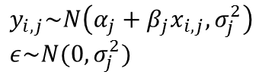







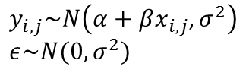
Hierarchical Bayesian Regression
Bayesian Regression
Hierarchical Bayesian Regression
$$y_{i,j}=α+βx_{i,j}+ε$$
$$y_{i,j}=α_{j}+β_{j}x_{i,j}+ε$$
$$y_{i,j}\sim N\left(α+βx_{i,j},σ^{2}\right)$$
$$ε\sim N(0,σ^{2})$$
$$y_{i,j}\sim N\left(α_{j}+β_{j}x_{i,j},σ_{j}^{2}\right)$$
$$ε\sim N(0,σ_{j}^{2})$$
Fixed hyper parameters
Fixed hyper parameters
$φ$
$$α,β,σ$$
parameter
$$α_{j},β_{j}$$
Per group parameter
$$y_{i}$$
$$σ_{j}$$
$$y_{i,j}$$
$$x_{i}$$
$$x_{i,j}$$
$$i=1,…,n$$
$$i=1,…,n_{j}$$
$$j=1,…,J$$

Slide 9
Hierarchical Bayesian Regression
Jupyter Demo Simulation
http://pymc-devs.github.io/pymc3/notebooks/GLM-hierarchical.html

Slide 10
Bayesian decision theory
Model has been built
The inferences are conducted
Model has been checked
What else?
Two ways of using Bayesian inference in decision making
(1) Measure uncertainties regarding predictive quantiles
Bayesian inference
?
Parameters
predictive quantities
Decision outcomes
(2) Within decision analysis (Multi-stages decision problems)
Earlier decision
Outcomes
Parameters
Decision
Final output come

Slide 11
Elements of Bayesian decision analysis
Decision analysis is inherently more complicated than statistical inference because it involves optimization over decision as well averaging over uncertainties
Elements of Bayesian decision analysis
1. Enumerate the space of all possible decisions (actions) $a$ and outcome $o$
-The vector of outcomes $o$ can include observables (predicted values $\tilde{y}$) and parameters $θ$
2. Determine $p(o|a)$, a conditional posterior probability distribution of outcomes $o$ for each decision option $a$
-Outcome $o$ is random variable, while decision $a$ is deterministic (set by user)
3. Define a utility function $U(o)$ mapping outcomes $o$ onto the real numbers
- If multiple attributes (vector) $o$ is considered, the utility function must trade off different goods
4. Compute the $E=$expected utility $E\left(U\left(o\right)|a\right)$ as a function of the decision $a$, and choose the decision with highest expected utility

Slide 12
Examples that will discussed in the lecture
Survey incentives
Conduct only step 1 and 2 to estimate the expected effect depending on the option that can be taken
Medical test decision
Conduct only step 1 and 2 in a sequential decision making and computed value of information
Risk analysis of Radon exposure and making prevention strategies
Conduct the full Bayesian analysis

Slide 13

Example 1: Survey incentives
Do the benefits of incentives outweigh the cost?
If an incentive is given,
how and when should it be offered
whom should it be offered to
what form should it take
how large should its value be?

Slide 14






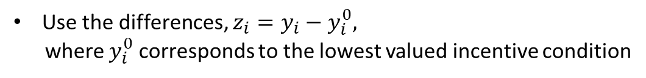



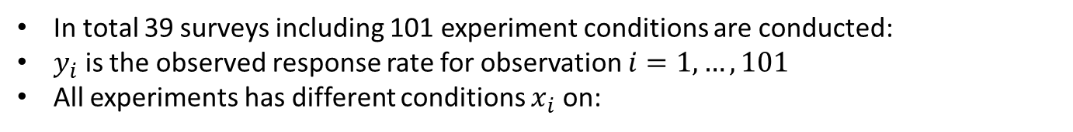




Example 1: Survey incentives
Data descriptions:
The New York City Social Indicators Survey, a telephone study conduced every two years that has had a response rate below 50%
Survey 1
Survey $j$
Survey 39
$${ x}_{1,1}$$
$${ x}_{n_{1},1}$$
$${ x}_{1,j}$$
$${ x}_{n_{j}j}$$
$${ x}_{1,39}$$
$${ x}_{n_{39}39}$$
$${ y}_{1,1}$$
$${ y}_{n_{1},1}$$
$${ y}_{1,j}$$
$${ y}_{n_{j}j}$$
$${ y}_{1,39}$$
$${ y}_{n_{39}39}$$
In total 39 surveys including 101 experiment conditions are conducted:
$y_{i}$ is the observed response rate for observation $i=1,…,101$
All experiments has different conditions $x_{i}$ on:
-The value of the incentive (in tens of 1999dollars)
-The timing of the incentive payment (given before the survey or after)
-The form of the incentive (cash or gift)
-The mode of the survey (face-to-face or telephone)
-The burden or effort, required to survey respondents (high burden or low burden)
Use the differences, $z_{i}=y_{i}−y_{i}^{0},$
where $y_{i}^{0}$ corresponds to the lowest valued incentive condition

Slide 15

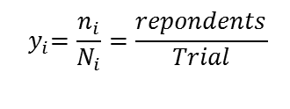
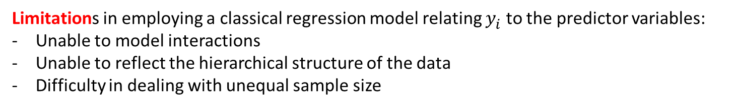
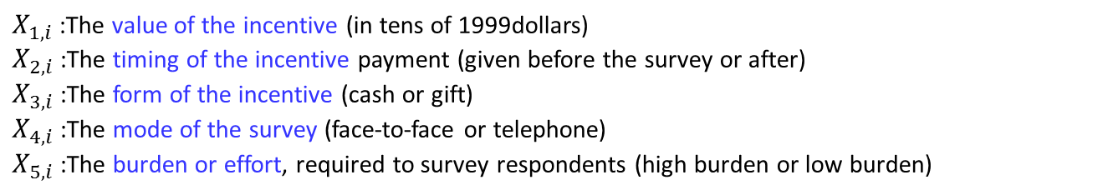
Example 1: Survey incentives
A simple linear regression approach
Response rate : $y_{i}=X_{i}β+β_{0}$
$${ y}_{i}=\frac{n_{i}}{N_{i}}=\frac{repondents}{Trial}$$
Predictor variables : $X_{i}=(X_{1,i},$ $X_{2,i}$, $X_{3,i}$, $X_{4,i}$, $X_{5,i})$
$X_{1,i}$ :The value of the incentive (in tens of 1999dollars)
$X_{2,i}$ :The timing of the incentive payment (given before the survey or after)
$X_{3,i}$ :The form of the incentive (cash or gift)
$X_{4,i}$ :The mode of the survey (face-to-face or telephone)
$X_{5,i}$ :The burden or effort, required to survey respondents (high burden or low burden)
Limitations in employing a classical regression model relating $y_{i}^{ }$ to the predictor variables:
Unable to model interactions
Unable to reflect the hierarchical structure of the data
Difficulty in dealing with unequal sample size

Slide 16
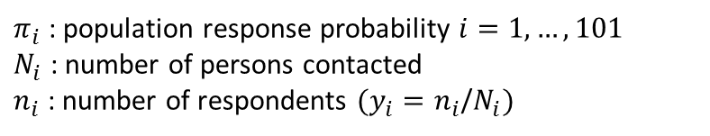






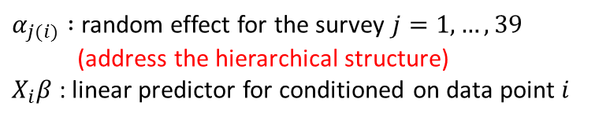
Example 1: Survey incentives
Step1 : perform a meta-analysis to estimate the effects of incentives on response rate, as a function of the amount of the incentive and the way it is implemented
$τ\sim U(0$,1$)$
$σ\sim U(0$,1$)$
$α_{j}\sim N(0$, $τ^{2})$
$β\sim U(0$,1$)$
$π_{i}\sim N(X_{i}β+α_{j(i)}$, $σ^{2})$
$n_{i}\sim Bin(N_{i}$, $π_{i})$
$α_{j(i)} :$ random effect for the survey $j=1,…,39$
(address the hierarchical structure)
$X_{i}β$ : linear predictor for conditioned on data point $i$
$π_{i}$ : population response probability $i=1,…,101$
$N_{i}$ : number of persons contacted
$n_{i}$ : number of respondents $(y_{i}=n_{i}$/$N_{i})$

Slide 17




















Example 1: Survey incentives
Step1 : perform a meta-analysis to estimate the effects of incentives on response rate, as a function of the amount of the incentive and the way it is implemented
$τ\sim U(0$,1$)$
Survey 1
$$α_{1}$$
Survey $j$
$$α_{j}$$
Survey 39
$$α_{39}$$
$α_{j}\sim N(0$, $τ^{2})$
$${ π}_{1,1}$$
$${ π}_{n_{1},1}$$
$${ π}_{1,j}$$
$${ π}_{n_{j}j}$$
$${ π}_{1,39}$$
$${ π}_{n_{39}39}$$
$π_{i,j}\sim N(X_{i}β+α_{j(i)}$, $σ^{2})$
$${ y}_{1,1}$$
$${ y}_{n_{1},1}$$
$${ y}_{1,j}$$
$${ y}_{n_{j}j}$$
$${ y}_{1,39}$$
$${ y}_{n_{39}39}$$
$$y_{i,j}\sim Bin(π_{i,j},N_{i,j})$$
$${ y}_{1,1}=\frac{n_{1,1}}{N_{i,i}}$$
Response rate

Slide 18
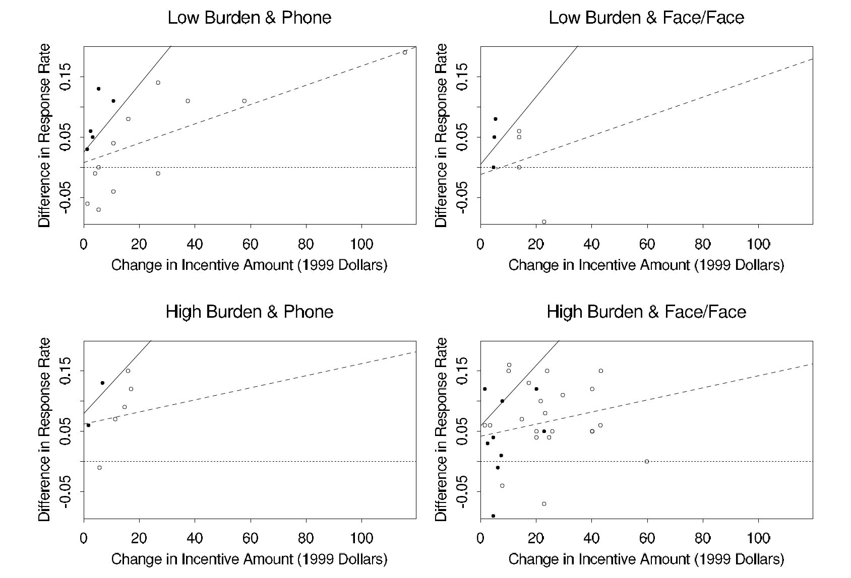

Example 1: Survey incentives
Step2 : use the inference to estimate the costs and benefits of incentives
Prepaid
$$y_{i}=X_{i}\hat{β}+β_{0}$$
After paid
Some of the findings are :
an extra $10 in incentive is expected to increase the response rate by 3–4 percentage points
cash incentives increase the response rate by about 1 percentage point relative to noncash
prepaid incentives increase the response rate by 1–2 percentage points relative to postpaid
incentives have a bigger impact (by about 5 percentage points) on high-burden surveys compared to low-burden surveys.
These inferences can be used to design a new survey (cost vs. response rate)

Slide 19
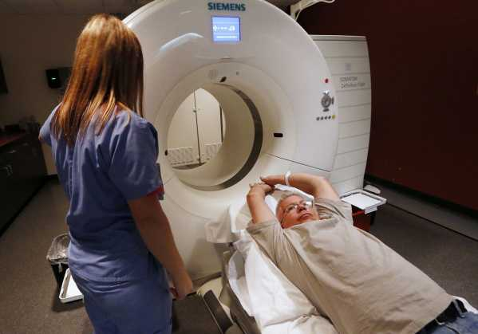
Example 2: Multistage decision making for medical screening
95-year-old man with an apparently malignant tumor in the lung
<Multi-stages decision problems>
Earlier decision
Test or not?
Outcomes
Parameters
Decision
Treatment type
Final output come
Bayesian inference is particularly useful in updating the state of knowledge with the information gained at each step.

Slide 20

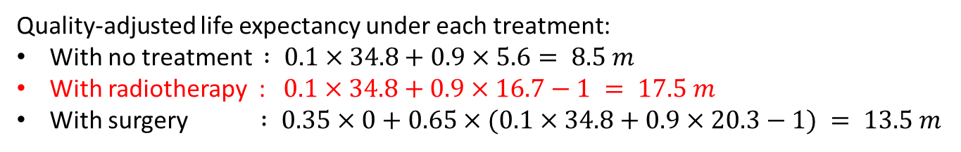







Example 2: Multistage decision making for medical screening
Single decision point (without test)
Treatment type ?
No treatment
Surgery
Radiotherapy
Cancer or not?
Die or alive ?
NC
C
NC
C
Die
alive
$$0.1$$
$$0.9$$
$$0.1$$
$$0.9$$
$$0.35$$
$$0.65$$
Cancer or not?
34.8 m
5.6 m
34.8 m
16.7 m
0 m
NC
C
$$0.1$$
$$0.9$$
34.8 m
20.3 m
Quality-adjusted life expectancy under each treatment:
With no treatment $: 0.1×34.8+0.9×5.6= 8.5 m$
With radiotherapy : $0.1×34.8+0.9×16.7−1 = 17.5 m$
With surgery $: 0.35×0+0.65×(0.1×34.8+0.9×20.3−1) = 13.5 m$
Best option

Slide 21
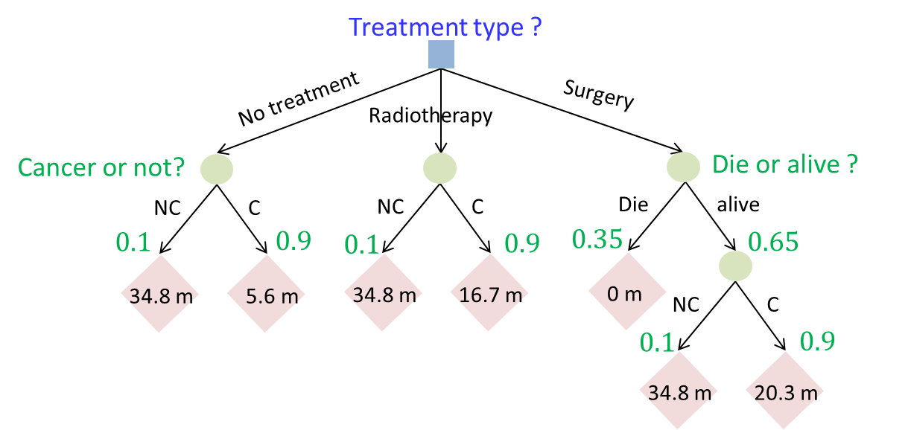
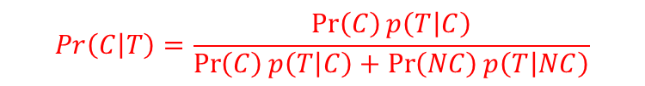
Example 2: Multistage decision making for medical screening
Sequential decision making
Test or not ?
No test
Do Test
Test results ?
Negative
Positive
Based on the test result, the probability of cancer can be updated using Bayes rule:
$$Pr\left(C | T\right)=\frac{\operatorname{Pr}\left(C\right)p\left(T | C\right)}{\operatorname{Pr}\left(C\right)p\left(T | C\right)+\operatorname{Pr}\left(NC\right)p\left(T | NC\right)}$$
Updated information can be used for sequential decision making

Slide 22










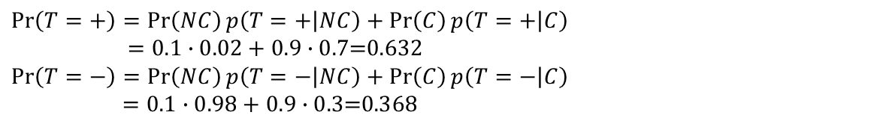






Example 2: Multistage decision making for medical screening
Update information based on the test results
Cancer ?
$$NC:0.1$$
$$C:0.9$$
Test result ?
Test result ?
$$p\left(+ | NC\right)$$
$$=0.02$$
$$p\left(− | NC\right)$$
$$=0.98$$
$$p\left(+ | C\right)$$
$$=0.70$$
$$p\left(− | C\right)$$
$$=0.30$$
$$0.1∙0.02$$
$$0.1∙0.98$$
$$0.9∙0.7$$
$$0.9∙0.3$$
$$\operatorname{Pr}\left(T=+\right)=\operatorname{Pr}\left(NC\right)p\left(T=+ | NC\right)+\operatorname{Pr}\left(C\right)p\left(T=+ | C\right)$$
$=0.1∙0.02+0.9∙0.7\text{=0.632}$
$$\operatorname{Pr}\left(T=−\right)=\operatorname{Pr}\left(NC\right)p\left(T=− | NC\right)+\operatorname{Pr}\left(C\right)p\left(T=− | C\right)$$
$=0.1∙0.98+0.9∙0.\text{3=0.368}$
$$Pr\left(C | T\right)=\frac{\operatorname{Pr}\left(C\right)p\left(T | C\right)}{Pr⁡(T)}$$
$$Pr\left(NC | T\right)=\frac{\operatorname{Pr}\left(NC\right)p\left(T | NC\right)}{Pr⁡(T)}$$
$$Pr\left(C | T=+\right)=\frac{0.9∙0.7}{0.1∙0.02+0.9∙0.7}=0.997$$
$$Pr\left(NC | T=+\right)=\frac{0.1∙0.7}{0.1∙0.02+0.9∙0.7}=0.003$$
$$Pr\left(C | T=−\right)=\frac{0.9∙0.3}{0.1∙0.98+0.9∙0.\text{3}}=0.734$$
$$Pr\left(NC | T=−\right)=\frac{0.1∙0.3}{0.1∙0.98+0.9∙0.\text{3}}=0.266$$

Slide 23
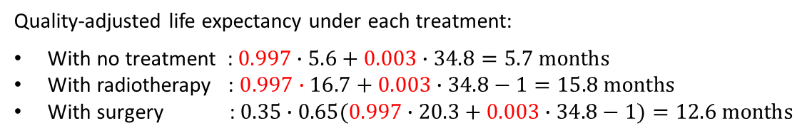
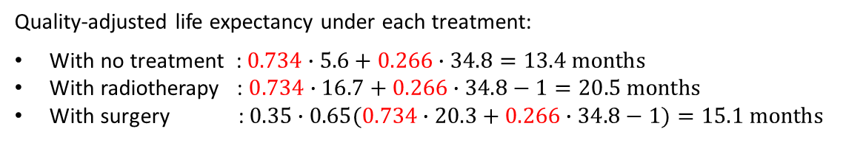
Example 2: Multistage decision making for medical screening
Choose the best action at the second stage using the updated information
$$Pr\left(cancer | T=+\right)=\frac{0.9∙0.7}{0.9∙0.7+0.1∙0.02}=0.997$$
Quality-adjusted life expectancy under each treatment:
With no treatment : $0.997∙5.6+0.003∙34.8=5.7 months$
With radiotherapy : $0.997∙16.7+0.003∙34.8−1=15.8 months$
With surgery : $0.35∙0.65(0.997∙20.3+0.003∙34.8−1)=12.6 months$
Best action
$$Pr\left(cancer | T=−\right)=\frac{0.9∙0.3}{0.9∙0.3+0.1∙0.98}=0.734$$
Quality-adjusted life expectancy under each treatment:
With no treatment :$0.734∙5.6+0.266∙34.8=13.4 months$
With radiotherapy : $0.734∙16.7+0.266∙34.8−1=20.5 months$
With surgery : $0.35∙0.65(0.734∙20.3+0.266∙34.8−1)=15.1 months$
Best action
It is clear conducting a test is not a good idea since no change in the selected option!

Slide 24
Example 2: Multistage decision making for medical screening
Sequential decision making
Test or not ?
No test
Do Test
Test results ?
Negative
Positive
When selecting a decision at the first state, we should assume that all the decisions at the subsequent stages will be made optimum!! (key idea of sequential decision making: Control, MDP)

Slide 25



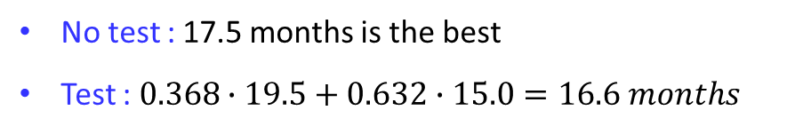


Example 2: Multistage decision making for medical screening
Decision analysis for performing test
No test
Do Test
Test result ?
$$17.5 months$$
With radiotherapy
$$p(T=−)$$
$$=0.368$$
$$p(T=+)$$
$$=0.632$$
$$0.95∙15.8=15.0 months$$
$$0.95∙20.5=19.5 months$$
With radiotherapy
With radiotherapy
($0.95$ is accounting for the 5% chance that the test can be fatal)
No test : 17.5 months is the best
Test : $0.368∙19.5+0.632∙15.0=16.6 months$
No change in the selected option and no improvement in the expected cost
→ Not conducting the test is the best option

Slide 26
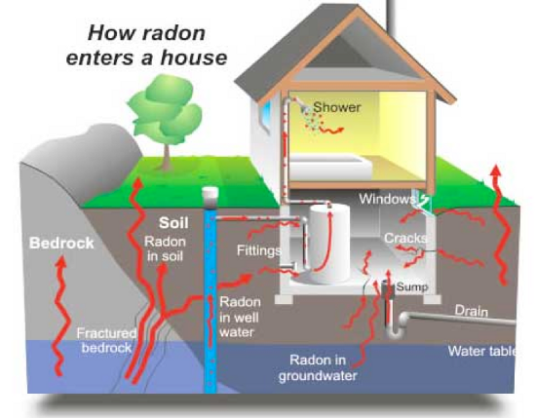
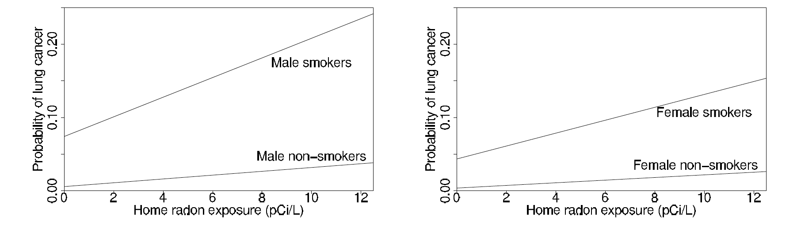
Example 3: Hierarchical decision analysis for home radon

Slide 27
Example 3: Hierarchical decision analysis for home radon
Do nothing
Test (50 $)
Remediate
Radon level?
2,000 $
Reduce Radon
exposure to 2 pCi/L
Do nothing
Remediate
50 $
50 $ + 2,000 $
Reduce Radon
exposure to 2 pCi/L
Two tasks:
Given prior information about Radon concentration, decide whether to conduct a measurement test (first decision)
Given the measurement of Radon concertation (we have a posterior of Radon con.), decide whether to remediate (second decision)
Performing the decision analysis requires estimating for the risks, which is done by using hierarchical Bayesian model

Slide 28
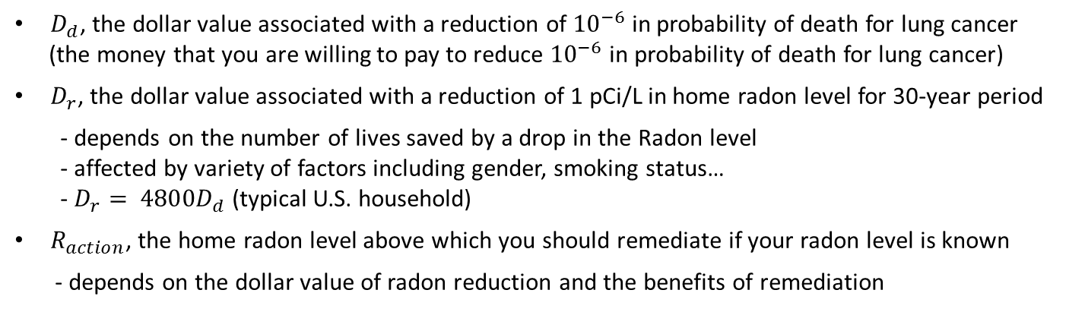
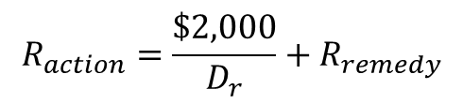
Example 3: Hierarchical decision analysis for home radon
Define utility : trades off dollars and lives
$D_{d}$, the dollar value associated with a reduction of ${10}^{−6}$ in probability of death for lung cancer
(the money that you are willing to pay to reduce ${10}^{−6}$ in probability of death for lung cancer)
$D_{r}$, the dollar value associated with a reduction of 1 pCi/L in home radon level for 30-year period
- depends on the number of lives saved by a drop in the Radon level
- affected by variety of factors including gender, smoking status…
- ${D_{r}= 4800D}_{d}$ (typical U.S. household)
$R_{action}$, the home radon level above which you should remediate if your radon level is known
- depends on the dollar value of radon reduction and the benefits of remediation
Action level $R_{action}$ is determined as the value at which the benefit of remediation
$$\$D_{r}{(R}_{action}−R_{remed})=remediation cost of \$2,000$$
$$R_{action}=\frac{\$2,000}{D_{r}}+R_{remedy}$$
$R_{action}=4$ pCi/L is used as exemplary value, which can vary depending on
financial resources, general risk tolerance, attitude toward risk, smoking status, etc.

Slide 29
Example 3: Hierarchical decision analysis for home radon
Bayesian inference for country radon level
Two data sets:
Long-term measurements from approximately 5,000 houses, selected as a cluster sample
from 125 randomly selected counties
Short-term measurements from about 80,000 houses, sampled at random
from all the counties in the U.S.
a relatively small amount of accurate data VS. a large amount of biased and imprecise data
Challenges:
Use the good data to calibrate the bad data, so that inference can be made about the
entire counties, not merely the 125 counties in the sample of long-term measurements

Slide 30


























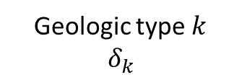



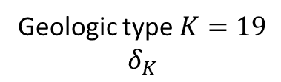


















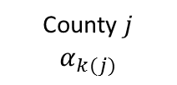















Example 3: Hierarchical decision analysis for home radon
Hierarchical modeling for individual house radon level
Nation
Geologic type $1$
$$δ_{1}$$
Geologic type $k$
$$δ_{k}$$
Geologic type $K=19$
$$δ_{K}$$
County $1$
County $1$
$$α_{k(1)}$$
County $1$
$$1$$
$$…$$
$$i$$
$$…$$
$$n$$
$$1$$
$$…$$
$$i$$
$$…$$
$$n$$
$$1$$
$$…$$
$$i$$
$$…$$
$$n$$
$$…$$
$$…$$
$$…$$
County $j$
$$…$$
County $j$
$$α_{k(j)}$$
County $j$
$$…$$
$$1$$
$$…$$
$$i$$
$$…$$
$$n$$
$$1$$
$$…$$
$$i$$
$$…$$
$$n$$
$$1$$
$$…$$
$$i$$
$$…$$
$$n$$
$$…$$
$$…$$
$$…$$
County $j$
County $J$
$$α_{k(J)}$$
County $j$
$$1$$
$$…$$
$$i$$
$$…$$
$$n$$
$$1$$
$$…$$
$$i$$
$$…$$
$$n$$
$$1$$
$$…$$
$$i$$
$$…$$
$$n$$

Slide 31













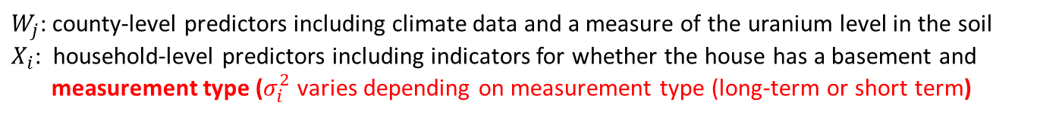
Example 3: Hierarchical decision analysis for home radon
Hierarchical modeling for individual house radon level
$$η$$
$$δ_{1}$$
Geological type $k$:
$$δ_{k}\sim N(0,η^{2})$$
$$δ_{K}$$
$$α_{1}$$
County $j$:
$$α_{j}\sim N(W_{j}γ+δ_{k}, τ^{2})$$
$$α_{J}$$
$$y_{1}$$
House $i$:
$$y_{i}\sim N(X_{i}β+α_{j}, σ_{i}^{2})$$
$$y_{n}$$
$W_{j}$: county-level predictors including climate data and a measure of the uranium level in the soil
$X_{i}$: household-level predictors including indicators for whether the house has a basement and
measurement type ($σ_{i}^{2}$ varies depending on measurement type (long-term or short term)

Slide 32

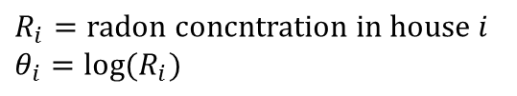
Example 3: Hierarchical decision analysis for home radon
Bayesian inference for individual home level
$$R_{i}=radon concntration in house i$$
$$θ_{i}=log⁡(R_{i})$$
$$θ_{i}\sim N(M_{i}, S_{i}^{2})$$
The mean $M_{i}=X_{i}\hat{B}+{\hat{α}}_{j}$ is computed from the posterior simulations of the model estimation.
$\hat{B}$ and ${\hat{α}}_{ }$are the posterior means from the analysis in the appropriate region of the country.
(computed from county level measurement data)
The variance $S_{i}^{2}$ is computed from the posterior simulations of the model estimation taking into account the posterior uncertainty in the coefficients $α$, $β$ and also hierarchical variance components $η^{2} and τ^{2}$
Serves as a prior distribution for the homeowner in that the distribution is constructed solely based on the basement information $X_{i}$ and the county level parameter ${\hat{α}}_{j}$
Using $p(θ_{i})$ Decision whether to perform measurement test or not can be made

Slide 33

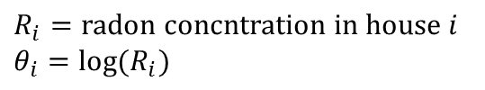


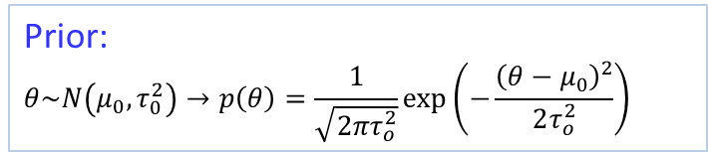

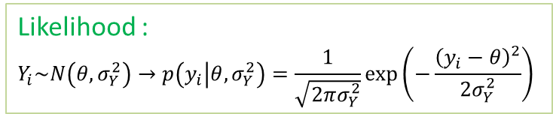


Example 3: Hierarchical decision analysis for home radon
Bayesian inference for individual home level
Likelihood :
$$Y_{i}\sim N\left(θ, σ_{Y}^{2}\right)→p\left(y_{i} | θ,σ_{Y}^{2}\right)=\frac{1}{\sqrt{2πσ_{Y}^{2}}}\exp\left(−\frac{{\left(y_{i}−θ\right)}^{2}}{2σ_{Y}^{2}}\right)$$
Prior:
$$θ\sim N\left(μ_{0}, τ_{0}^{2}\right)→p\left(θ\right)=\frac{1}{\sqrt{2πτ_{o}^{2}}}\exp\left(−\frac{{\left(θ−μ_{0}\right)}^{2}}{2τ_{o}^{2}}\right)$$
Posterior on $θ=μ_{Y}$
$$=N\left(θ | \frac{\frac{μ_{0}}{τ_{0}^{2}}+\frac{n\overline{y}}{σ_{Y}^{2}}}{\frac{1}{τ_{0}^{2}}+\frac{n}{σ_{Y}^{2}}},{\left(\frac{1}{τ_{0}^{2}}+\frac{n}{σ_{Y}^{2}}\right)}^{−1}\right)$$
$$P(θ|y)$$
$$R_{i}=radon concntration in house i$$
$$θ_{i}=log⁡(R_{i})$$
Assume we measure Radon concentration $y_{i}\sim N(θ_{i},σ_{i}^{2})$
Prior (from previous slide) :
Likelihood
$$p(θ_{i})=N(M_{i}, S_{i}^{2})$$
$y_{i}\sim N(θ_{i},σ_{i}^{2})$
The posterior distribution :
$Λ_{i}=\frac{\frac{M_{i}}{S_{i}^{2}}+\frac{y_{i}}{σ_{i}^{2}}}{\frac{1}{S_{i}^{2}}+\frac{1}{σ_{i}^{2}}}$ $V_{i}=\frac{1}{\frac{1}{S_{i}^{2}}+\frac{1}{σ_{i}^{2}}}$
$$θ_{i}|M_{i}, y_{i}\sim N(Λ_{i}, V_{i})$$

Slide 34


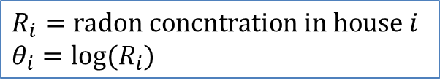
Example 3: Hierarchical decision analysis for home radon
Decision analysis for individual homeowners
$$R_{i}=radon concntration in house i$$
$$θ_{i}=log⁡(R_{i})$$
Prior : $θ_{i}=N(M_{i}, S_{i}^{2})$
Predictive distribution based on hierarchical model
Decision whether to perform measurement test or not
Posterior :$θ_{i}|M_{i}, y_{i}\sim N(Λ_{i}, V_{i})$
Decision whether to remediate or not

Slide 35

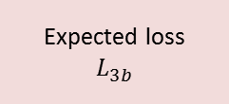
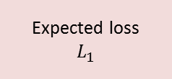
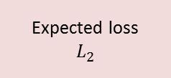


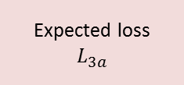
Example 3: Hierarchical decision analysis for home radon
Predictive distribution
based on hierarchical model
Prior : $θ_{i}=N(M_{i}, S_{i}^{2})$
Do nothing
Test (50 $)
Remediate
Radon level?
Expected loss
$$L_{1}$$
Expected loss
$$L_{2}$$
Posterior :$θ_{i}|M_{i}, y_{i}\sim N(Λ_{i}, V_{i})$
Do nothing
Remediate
Expected loss
$$L_{3a}$$
Expected loss
$$L_{3b}$$
Expected loss = cost + $D_{r}E(R)$

Slide 36
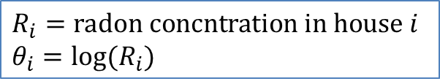

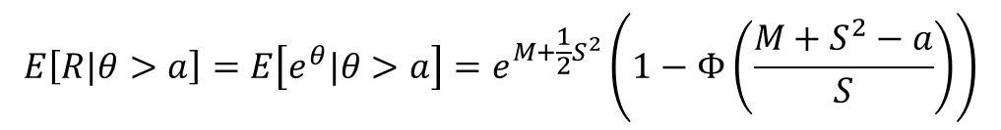
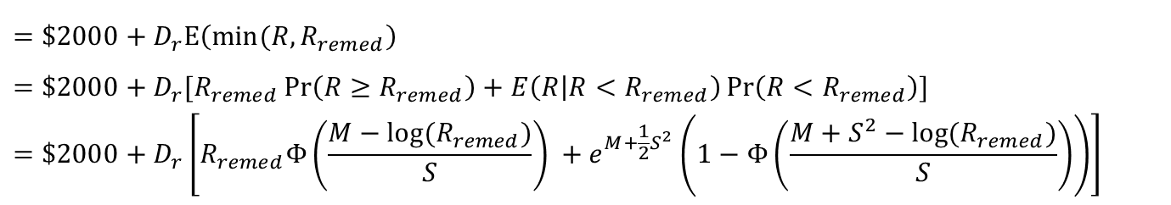



Example 3: Hierarchical decision analysis for home radon
Decision analysis for individual homeowners
$$R_{i}=radon concntration in house i$$
$$θ_{i}=log⁡(R_{i})$$
$$R=e^{θ}, θ\sim N(M,S^{2})$$
$$E\left[R\right]=E\left[e^{θ}\right]=e^{M+\frac{1}{2}S^{2}}$$
$$E\left[R|θ>a\right]=E\left[e^{θ}|θ>a\right]=e^{M+\frac{1}{2}S^{2}}\left(1−Φ\left(\frac{M+S^{2}−a}{S}\right)\right)$$
Do nothing
$$L_{1}=D_{r}E\left(R\right)=D_{r}e^{M+\frac{1}{2}S^{2}}$$
Remediate without test
$$L_{2}$$
$$=\$2000+D_{r}E\left(\min{(R, R_{remed}}\right)$$
$$=\$2000+D_{r}[R_{remed}\operatorname{Pr}\left(R≥R_{remed}\right)+E\left(R | R<R_{remed}\right)\operatorname{Pr}\left(R<R_{remed}\right)]$$
$$=\$2000+D_{r}\left[R_{remed}Φ\left(\frac{M−log⁡(R_{remed})}{S}\right) +e^{M+\frac{1}{2}S^{2}}\left(1−Φ\left(\frac{M+S^{2}−log⁡(R_{remed})}{S}\right)\right)\right]$$

Slide 37

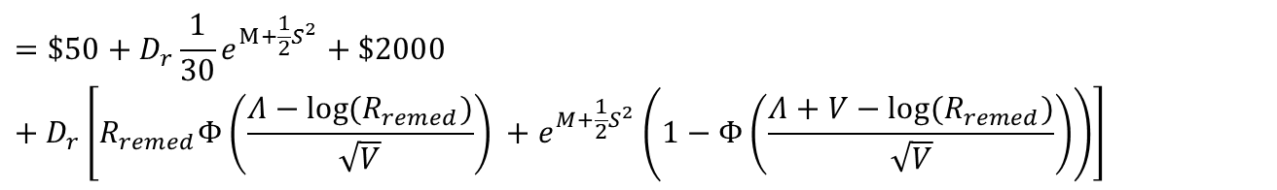



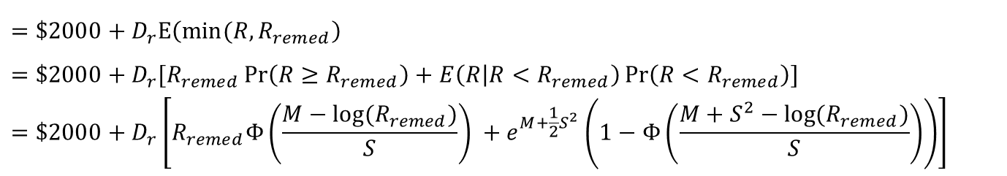

Example 3: Hierarchical decision analysis for home radon
Decision analysis for individual homeowners
Remediate without test
$$L_{2}$$
$$=\$2000+D_{r}E\left(\min{(R, R_{remed}}\right)$$
$$=\$2000+D_{r}[R_{remed}\operatorname{Pr}\left(R≥R_{remed}\right)+E\left(R | R<R_{remed}\right)\operatorname{Pr}\left(R<R_{remed}\right)]$$
$$=\$2000+D_{r}\left[R_{remed}Φ\left(\frac{M−log⁡(R_{remed})}{S}\right) +e^{M+\frac{1}{2}S^{2}}\left(1−Φ\left(\frac{M+S^{2}−log⁡(R_{remed})}{S}\right)\right)\right]$$
Prior
$$\left(M,S^{2}\right)$$
Perform measurement test
Do nothing
$$(Λ, V)$$
$$L_{3a}=\$50+D_{r}\frac{1}{30}e^{M+\frac{1}{2}S^{2}}+D_{r}e^{Λ+\frac{1}{2}V}$$
Posterior
Exposure of 1 year
29 years of exposure after test is done
Remediate
$$L_{3b}$$
$$=\$50+D_{r}\frac{1}{30}e^{M+\frac{1}{2}S^{2}}+\$2000+D_{r}\left[R_{remed}Φ\left(\frac{Λ−log⁡(R_{remed})}{\sqrt{V}}\right) +e^{M+\frac{1}{2}S^{2}}\left(1−Φ\left(\frac{Λ+V−log⁡(R_{remed})}{\sqrt{V}}\right)\right)\right]$$

Slide 38
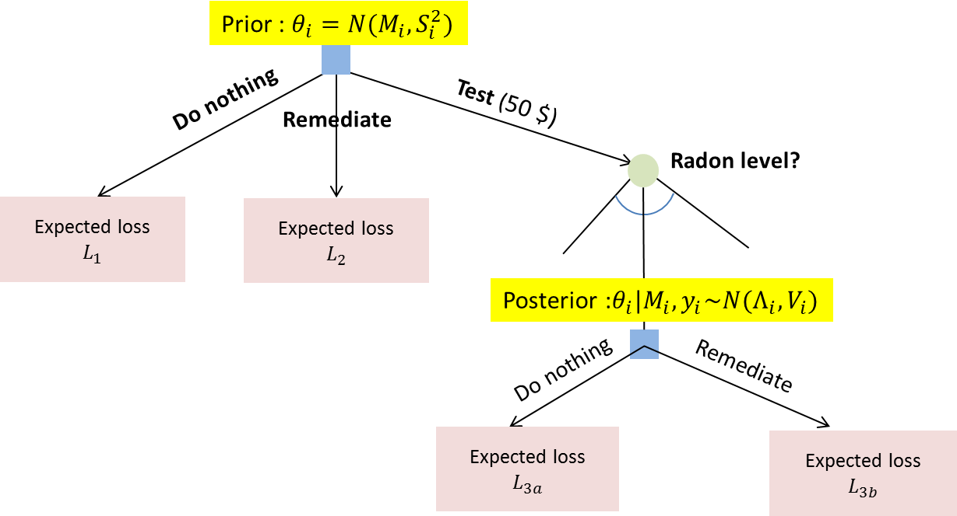

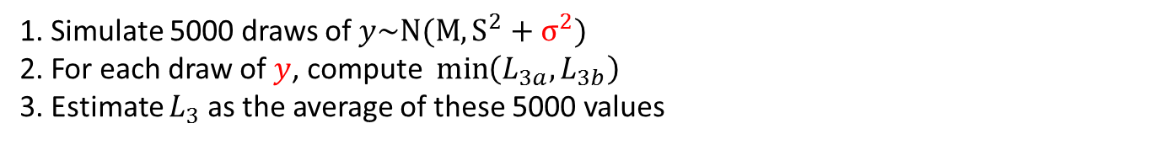

Example 3: Hierarchical decision analysis for home radon
Decision analysis for individual homeowners
$$L_{3}$$
Expected loss for performing test : $L^{3}=E\left(\min\left(L_{3a},L_{3b}\right)\right)$ :
(optimum decision in the second state is imbedded)
1. Simulate 5000 draws of $y\sim N(M, S^{2}+σ^{2})$
2. For each draw of $y$, compute $\min\left(L_{3a},L_{3b}\right)$
3. Estimate $L_{3}$ as the average of these 5000 values
(Considering uncertainty of $y$)

Slide 39
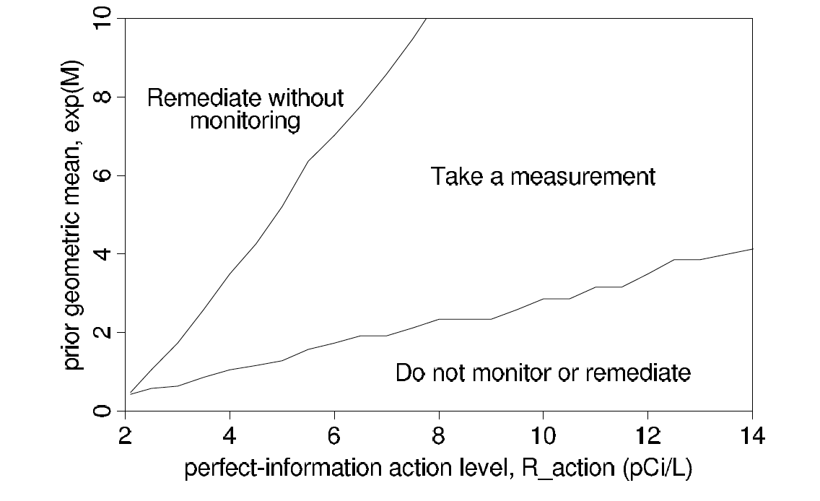
Example 3: Hierarchical decision analysis for home radon
Decision analysis for individual homeowners

